Slide 1
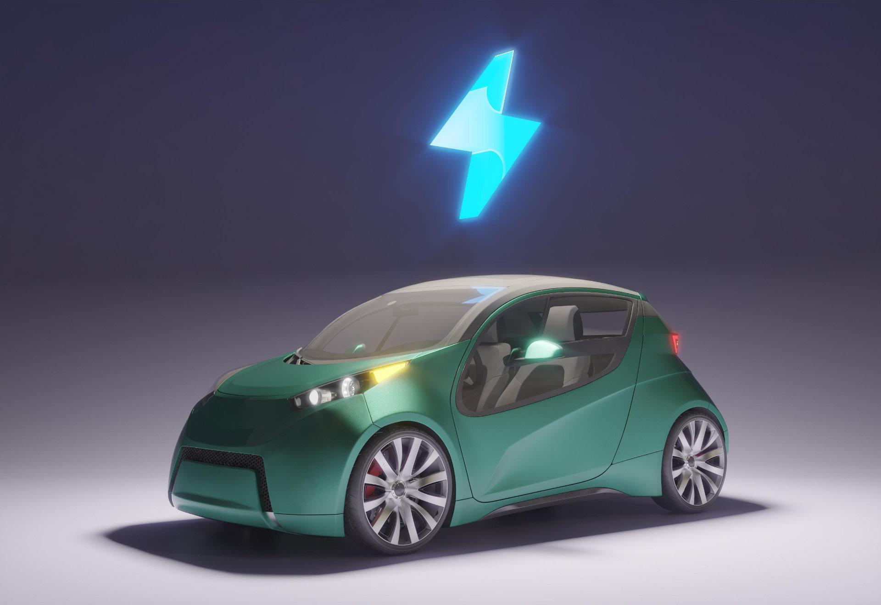

NEXUS-X
KRISHNA SINHA

Slide 2
PROBLEMS
BATTERY HEALTH AND DEGRADATION
UNEVEN DISTRIBUTION OF CHARGING STATIONS
USER PREFERENCES
LIMITED CHARGING OPTIONS FOR APARTMENTS/CONDO DWELLERS
RANGE ANXIETY
OPTIMAL ROUTE MAP
LOCATING CHARGING STATIONS
WAITING TIME

Slide 3
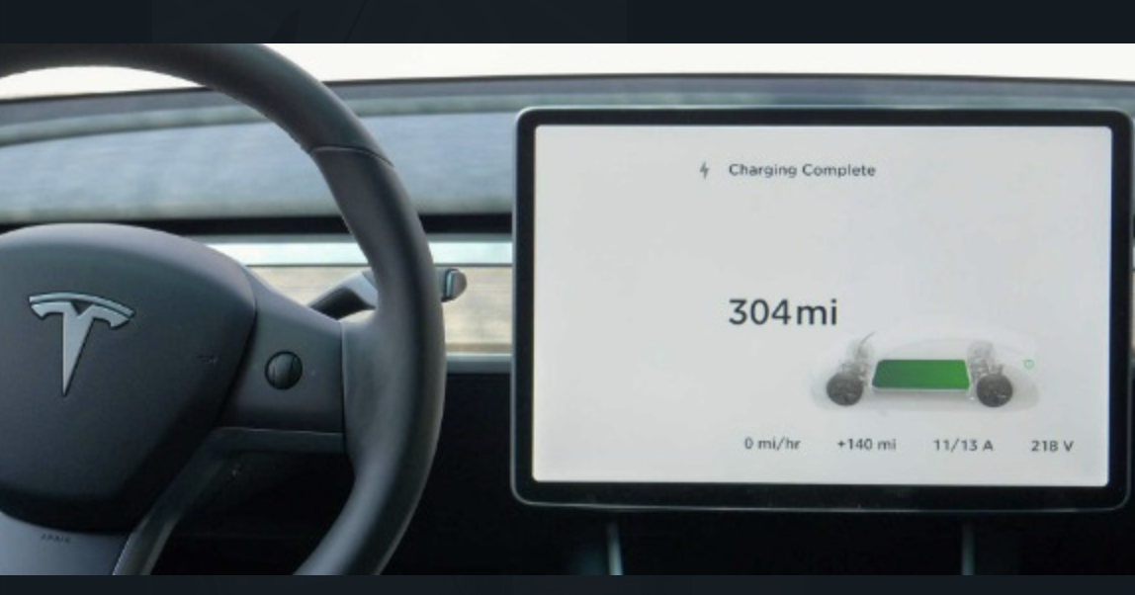

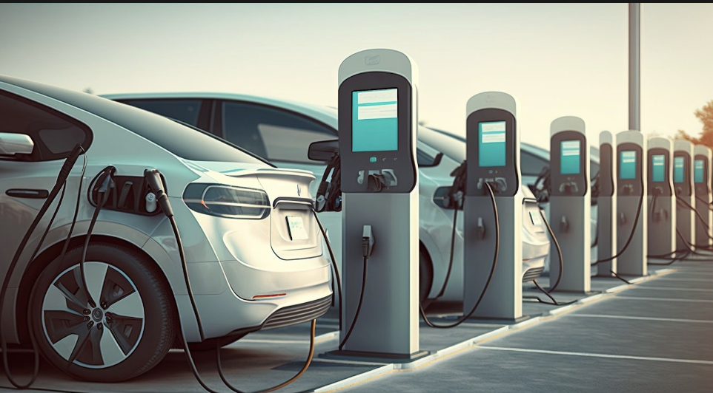
FOR USERS
1) ML model for range prediction of vehicles.
2) ML model for route optmization.
3) Can request for EV charging station in their area (on the basis of number of requests)

Slide 4
ML model for range prediction of vehicles.
Based on
1) Battery temperature
2) Weight of body
3) Usage of Air Conditioner
4) Speed of the vehicle
5) Weather condition

Slide 5
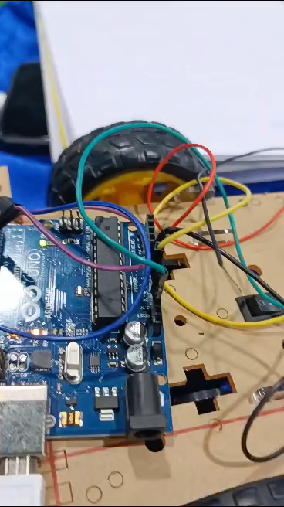
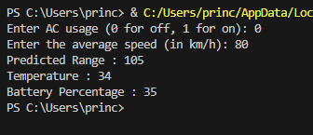
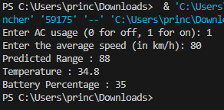
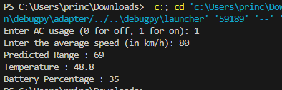

Slide 6
ML model for route optmization.
1) User charging preference
2) Charging type
3) Avaialability ( rush at charging slots )
4) Closest to the route
5) Based on range and usage prediction

Slide 7
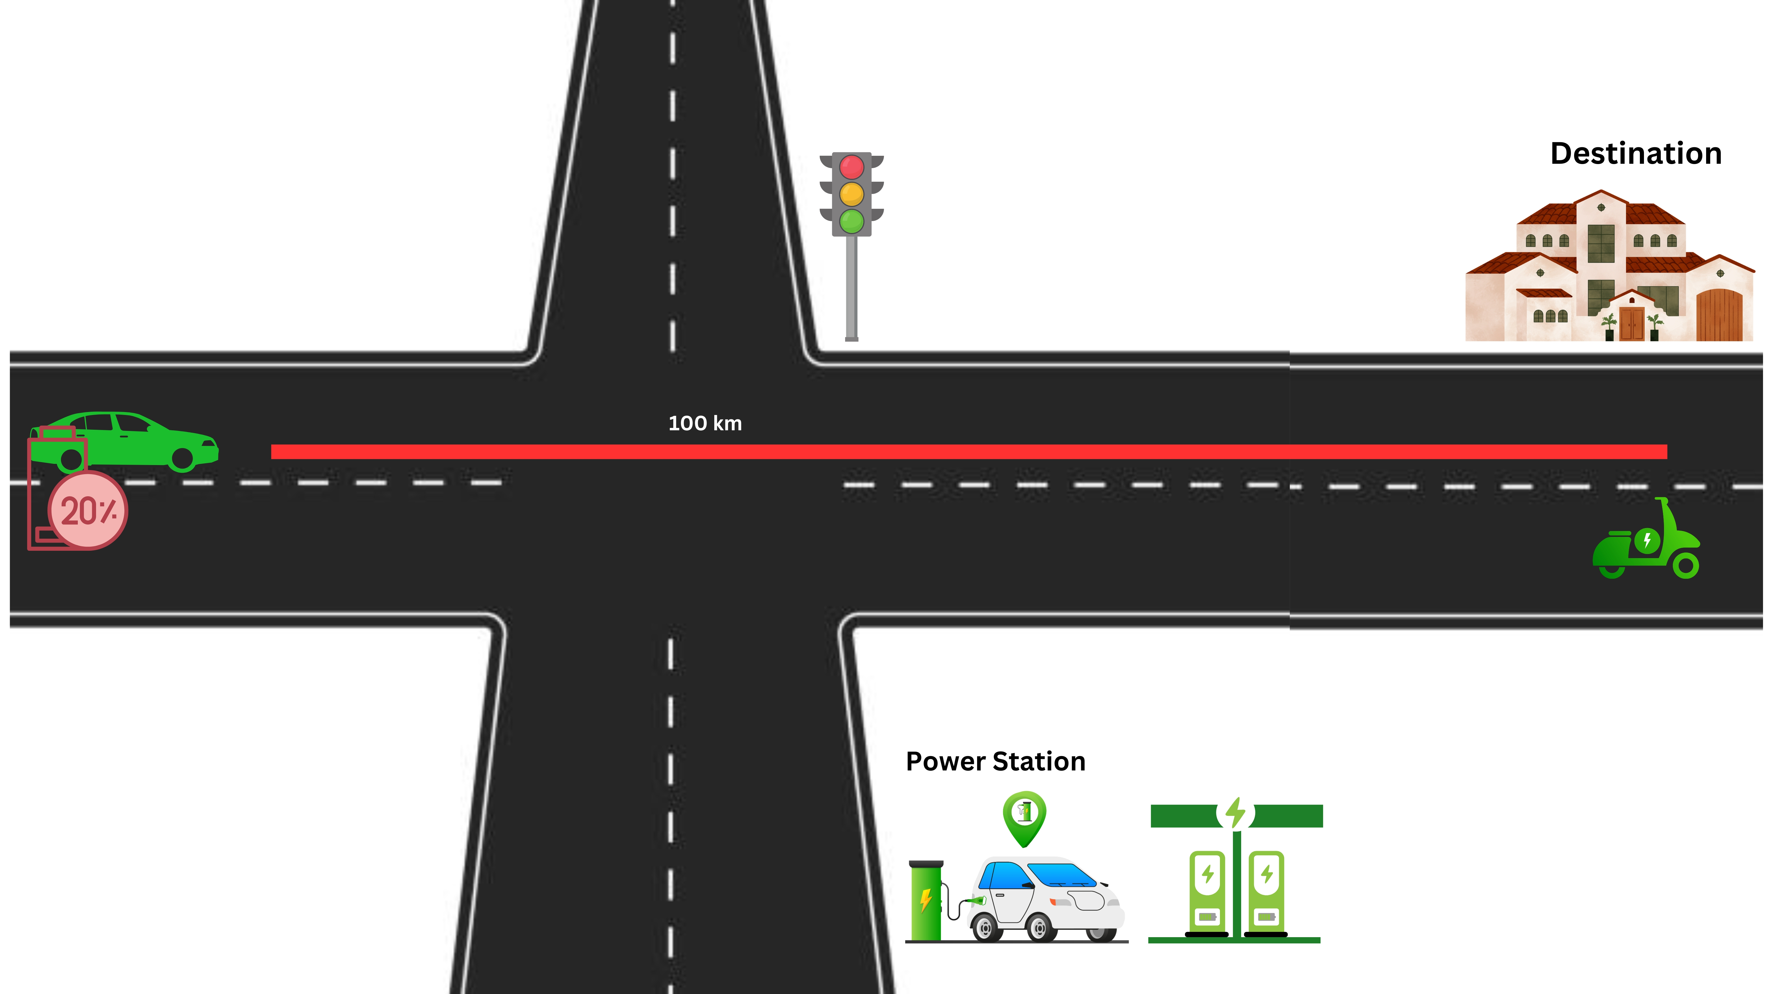

Slide 8
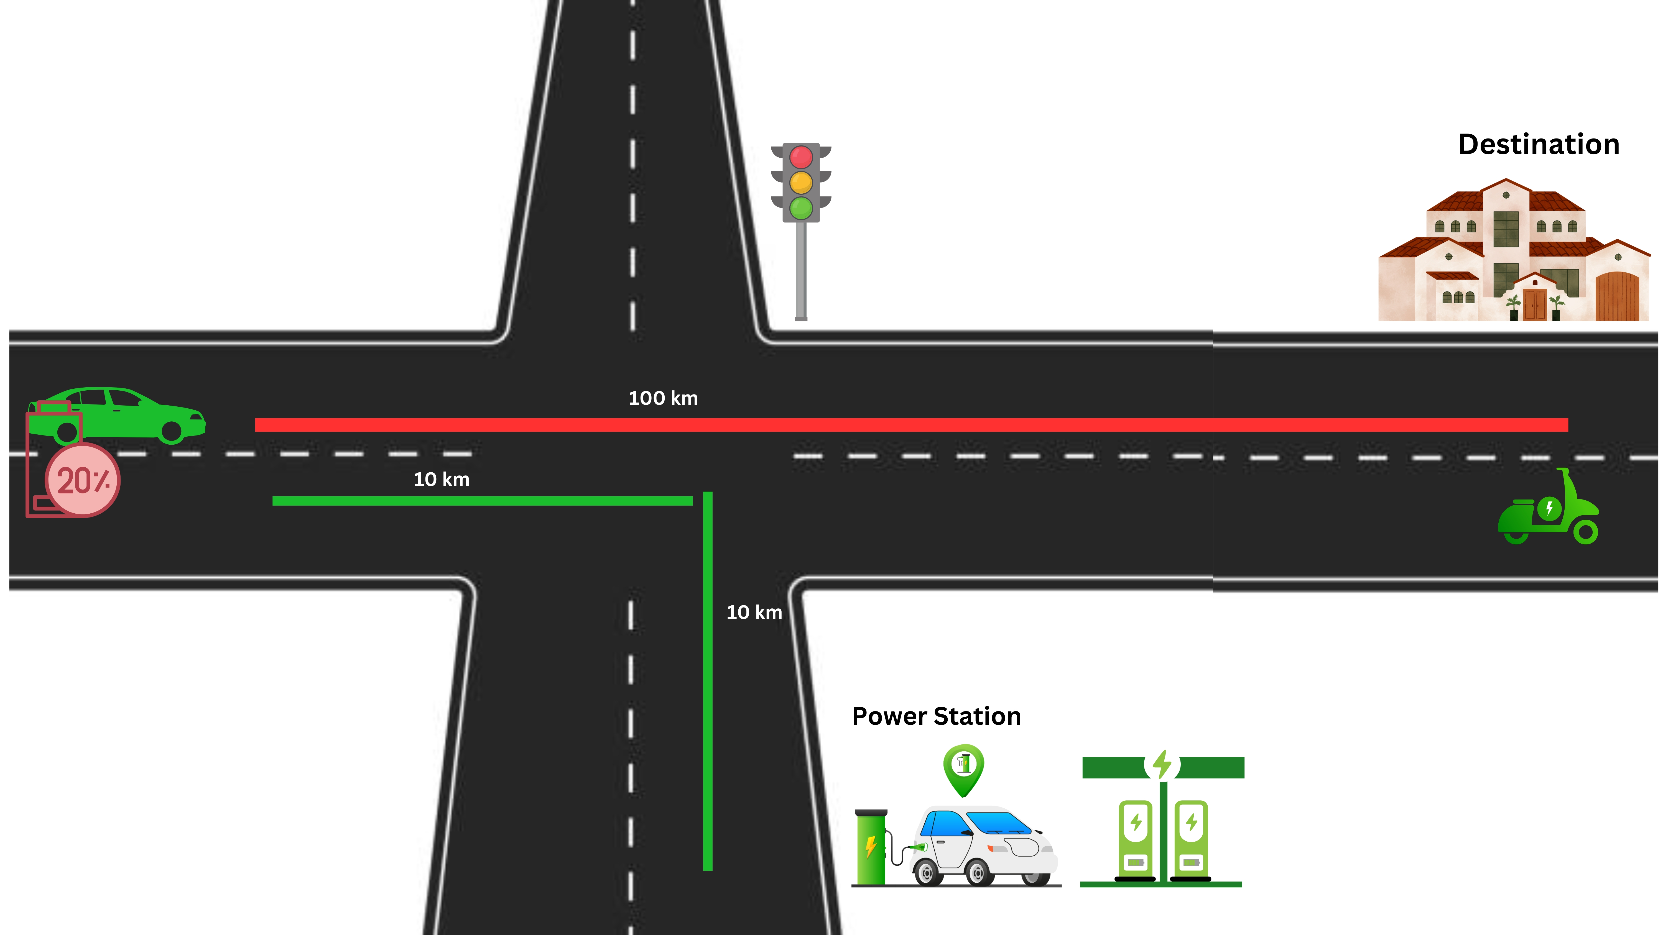

Slide 9
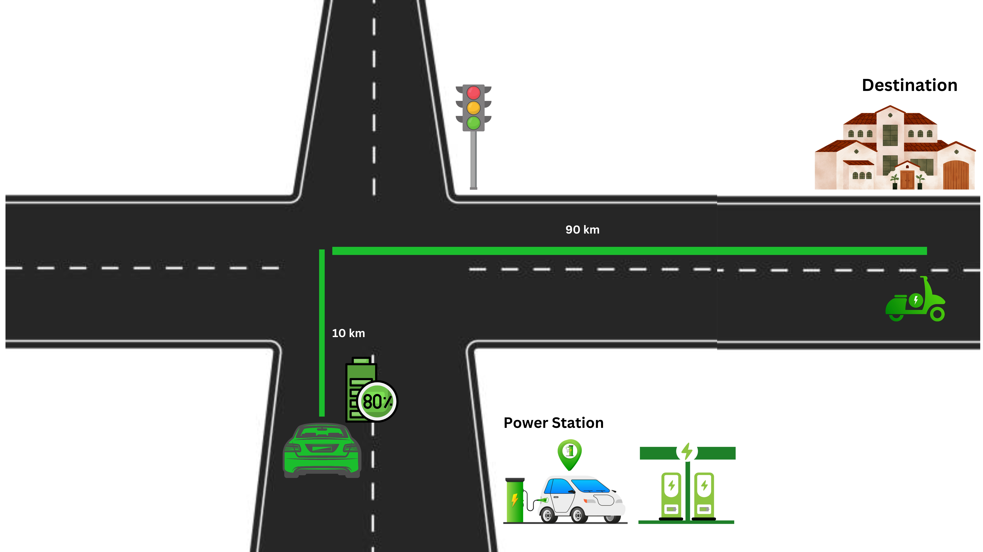

Slide 10


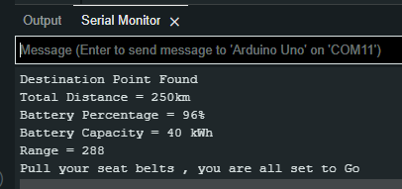
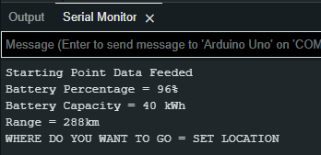
SERIAL MONITOR OUTPUTS
1
3
2
4

Slide 11
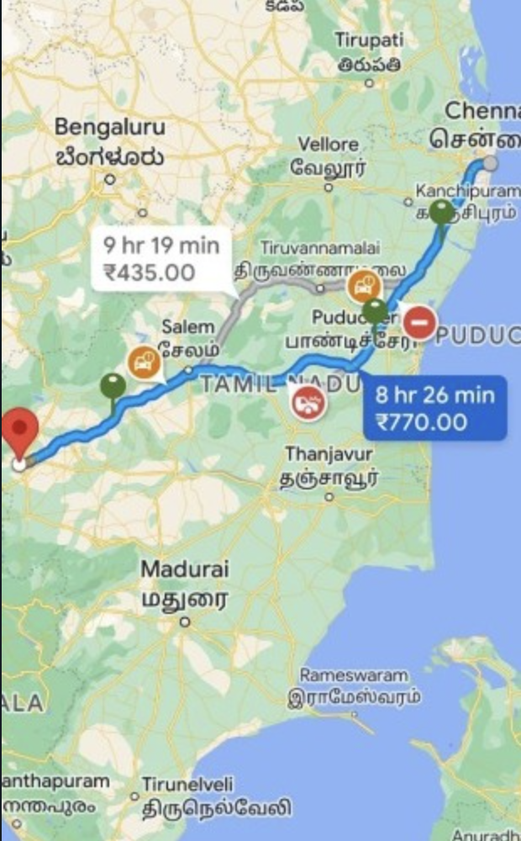


Slide 12

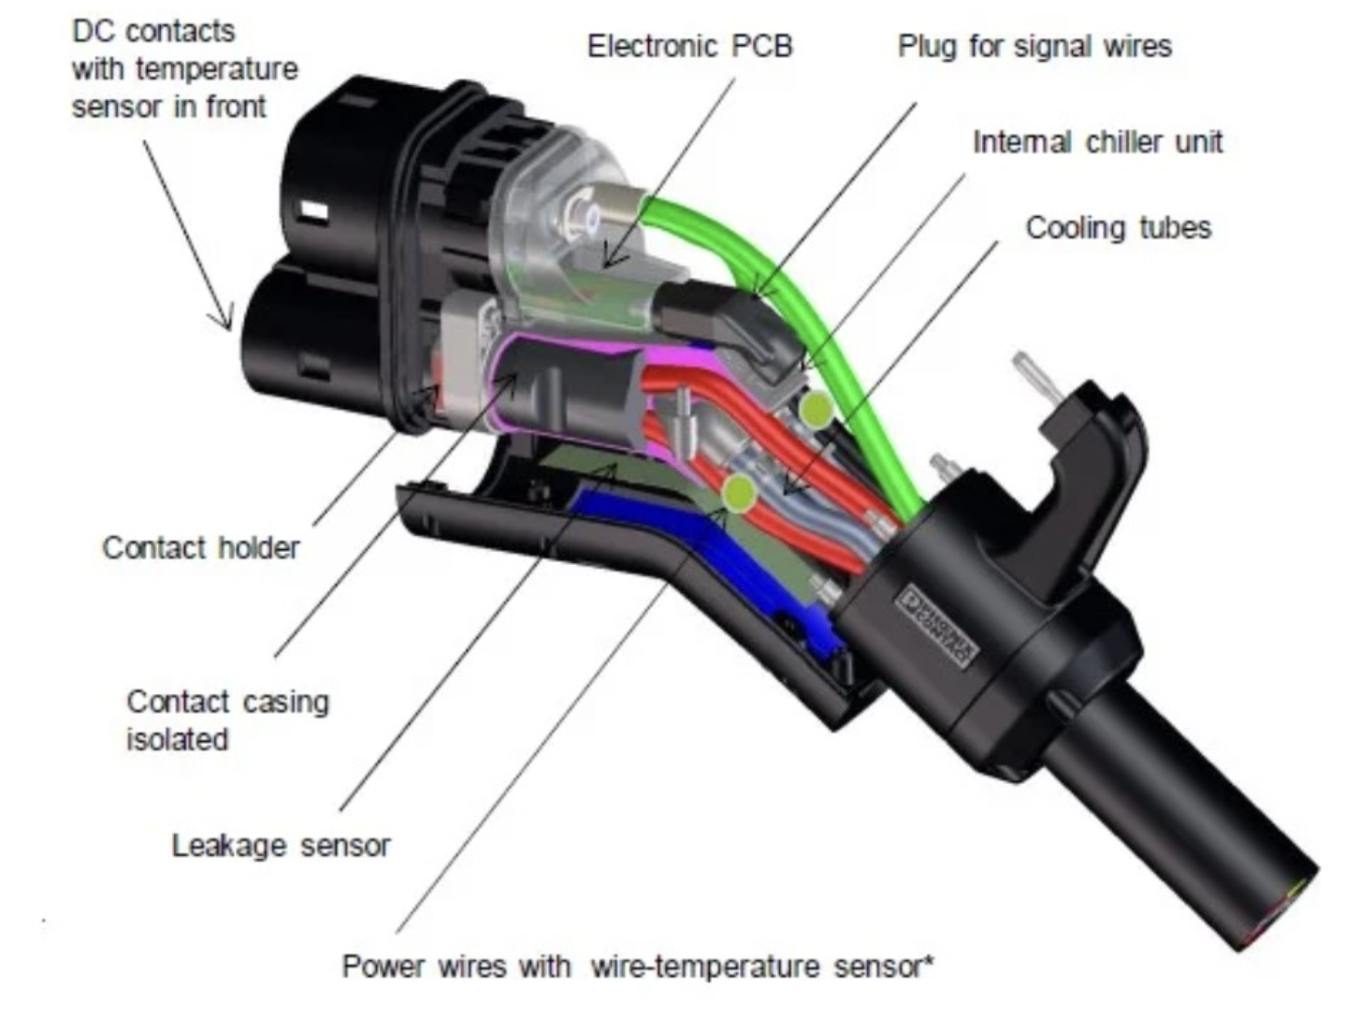

FOR EV OWNERS AND SMART CITY PLANNERS
1) ML model for EV charging station placement in grid.
2) charging wires for cooling systems.
3) Maintainance of charging machines .
( Resistance of wire , temperature measuring )

Slide 13
ML model for EV charging station placement in grid.
1) User availabity
2) Solar intensity
3) Wind intensity
4) Suitable location
5) Profitable

Slide 14
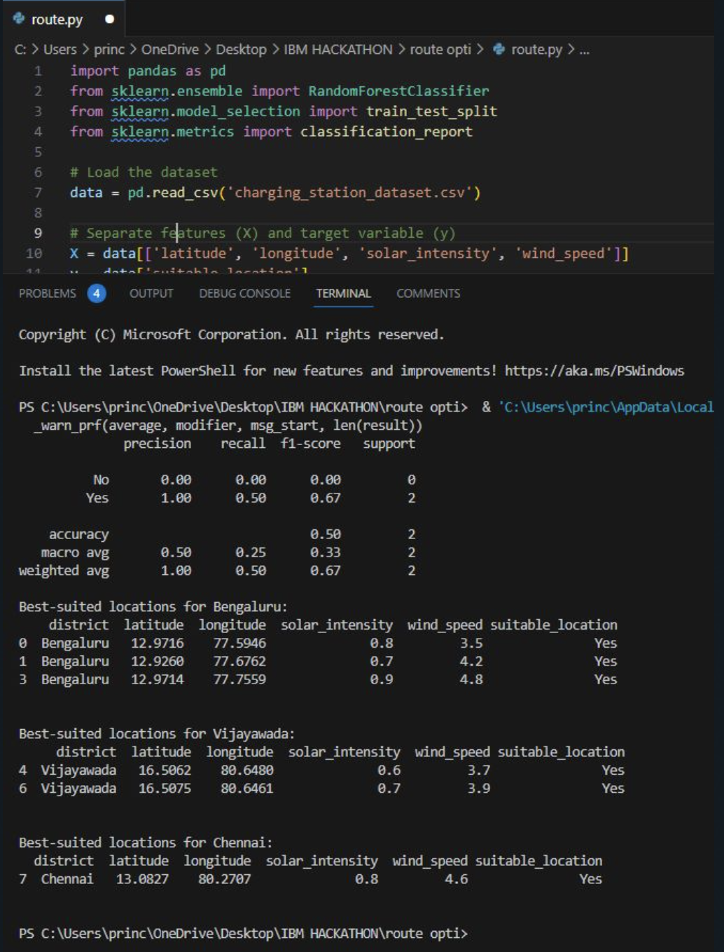

Slide 15
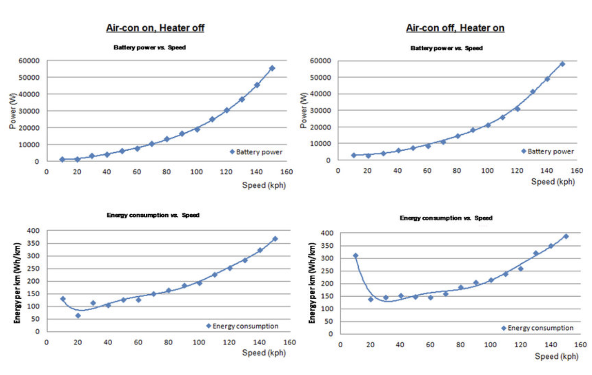
EFFECTIVENESS AND EFFICENCY
Effectiveness based on EV focuses on decision-making
that maximizes expected value, prioritizing actions with
the highest potential for favorable outcomes.
Efficiency based on EV emphasizes achieving desired outcomes while optimizing resource allocation to minimize waste or maximize productivity.
By considering both effectiveness and efficiency within an expected value framework, individuals and organizations can make informed decisions and allocate resources strategically to achieve their goals.

Slide 16
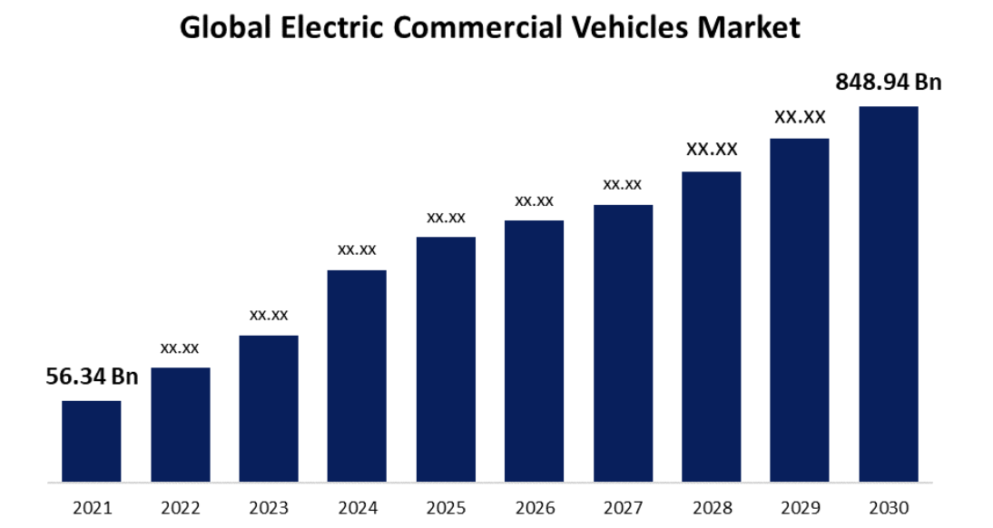
COMERCIAL VALUE
The commercial value of electric vehicles (EVs) encompasses several factors that contribute to their appeal in the market. Here are some key aspects of commercial value for EVs:
1) Cost Savings
2) Environmental Benefits
3) Energy Efficiency
4) Performance and Innovation
5) Corporate Social Responsibility
6) Market Growth Potential
The commercial value of EVs lies in their cost savings, environmental benefits, energy efficiency, performance, innovation, alignment with corporate social responsibility, and market growth potential. As these advantages continue to expand and evolve, the commercial value of EVs is expected to further increase in the coming years.

Slide 17
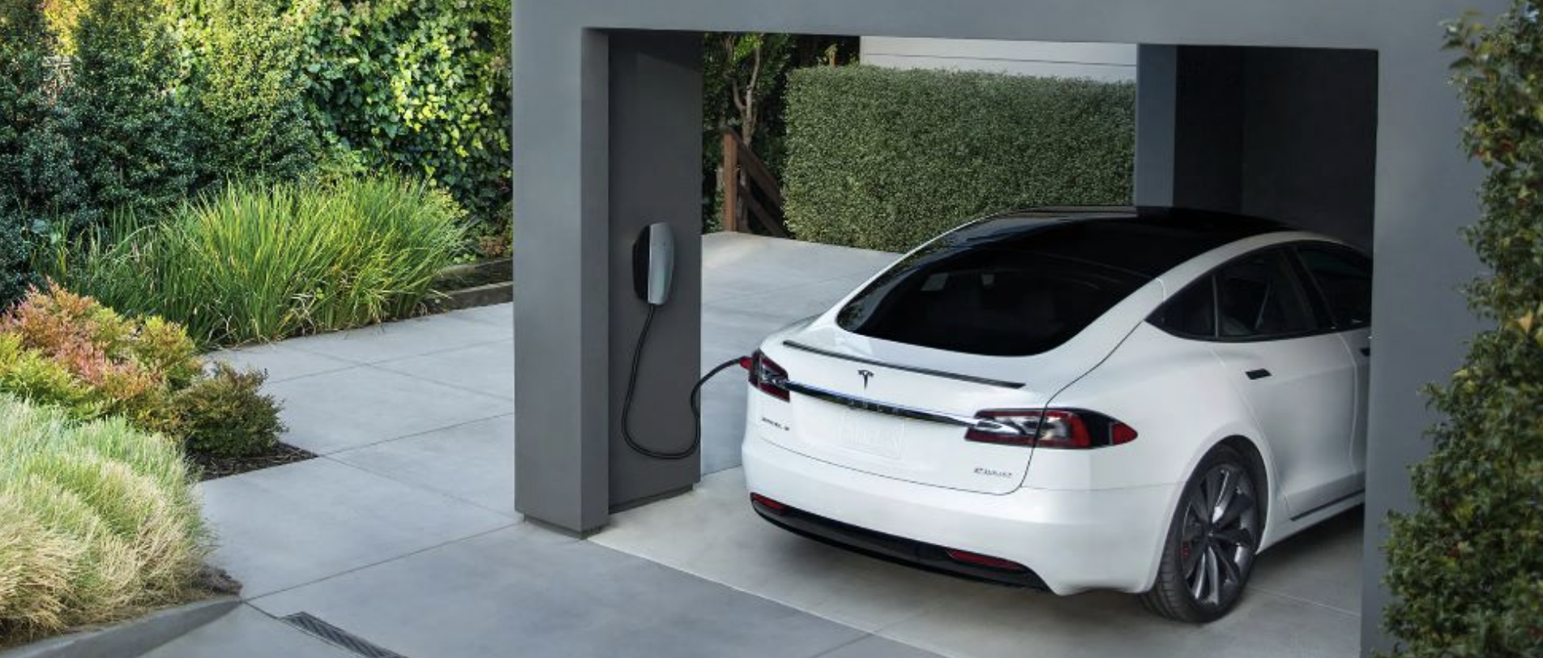
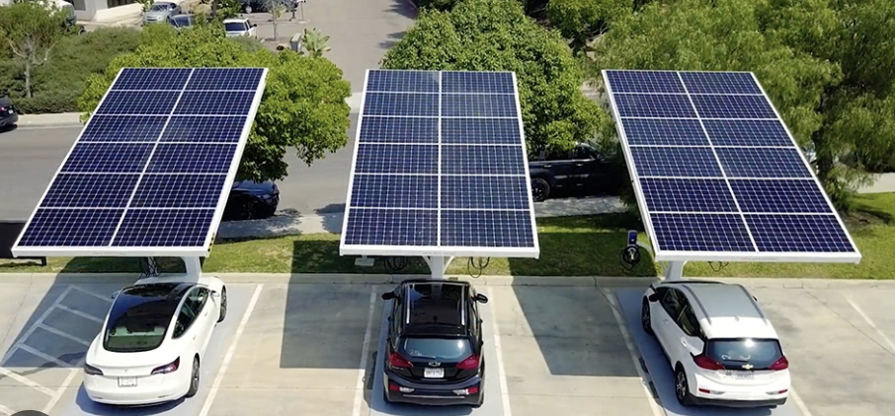
BUSINESS FOR COMMON PEOPLE
1) Can avail a home based charging sockets
for EV vehicles and can make money.
- Government autherization paper work
subsides for solar based charging stations.

Slide 18
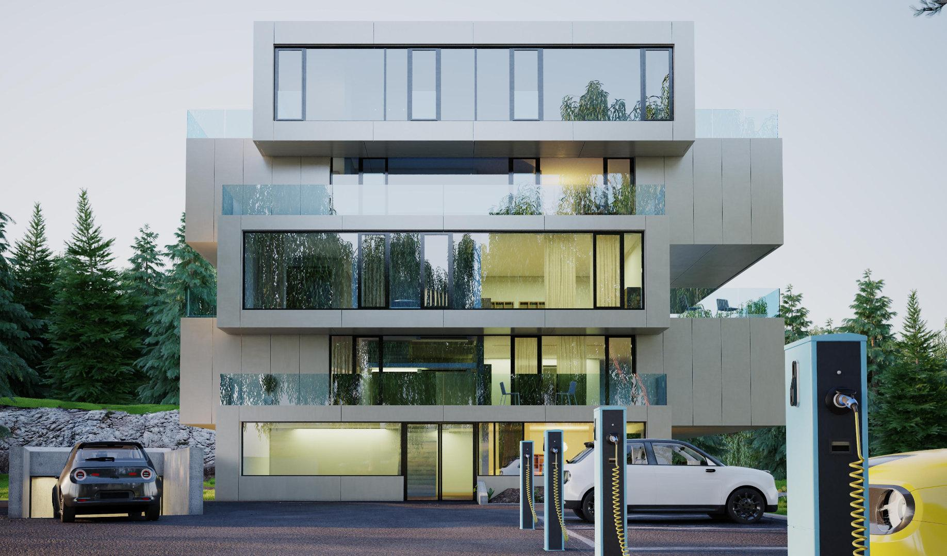
A PICTURE IS WORTH A THOUSAND WORDS

Slide 19

HOME BASED COMERCIAL CHARGING STATIONS
BENIFITS:
Convenience
State-of-the-Art Equipment
Eco-Friendly
Reliable Service
Competitive Pricing
Promoting Sustainable Future

Slide 20
Budgeting the product
Expense | Cost Range (INR)
Charging Equipment | 15,000 - 50,000
Electrical Installation | 10,000 - 30,000
Online Booking and Payment Platform | 1200 per year
Online Portal Development | 20,000 - 50,000
Marketing and Promotion | 10,000 - 50,000
Maintenance and Support | 1000-2000
Revenue (individual) | Amount (INR) | For 100 customers per month (avg 20 kWH) | For Company
Monthly Revenue from Charging | 12-14 per KWH energy + service taxes | 13*20*100= 26000 | 5% = 1300
Monthly Operational Costs | 6-10 per KWH | 16000 | For 150000 user with these stations running = 1300*15000
Monthly Profit | 2-6 per KWH energy | 10000 | 19,50,000

Slide 21
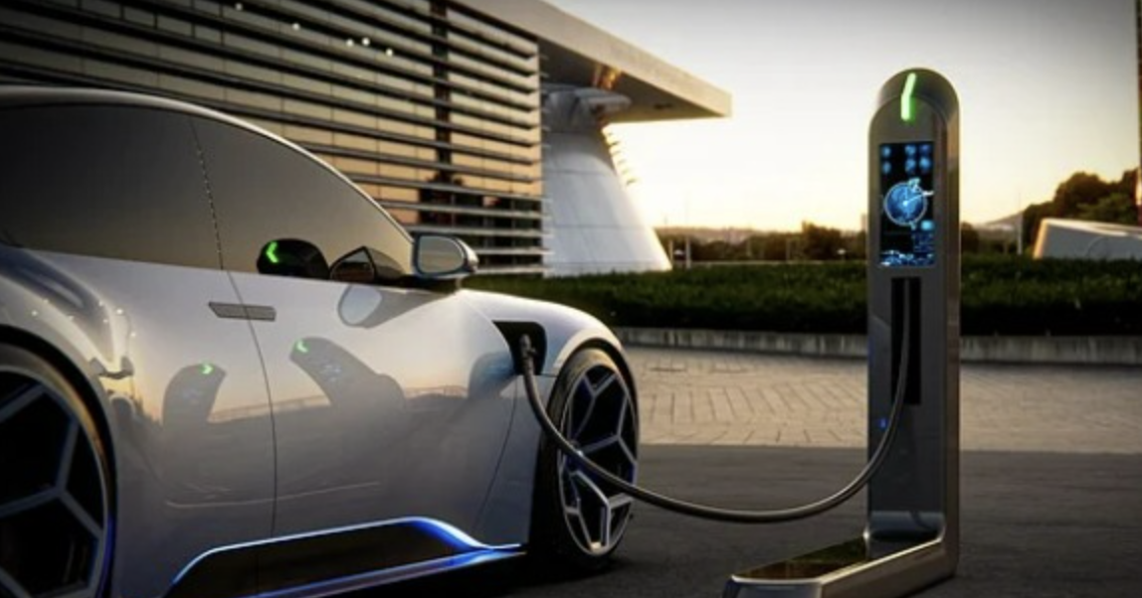
LIQUID COOLING SYSTEMS
A mixture of water and glycol, such as ethylene glycol or propylene glycol, can be an economical option for coolant. These mixtures are commonly used in automotive cooling systems and offer good heat transfer capabilities. However, they may require additional anti-corrosion additives and periodic maintenance.
^{C}₂^{H}₆^{O}₂ ^{+ H}₂^{O → C}₂^{H}₈^{O}₃
The resulting solution, commonly known as coolant or antifreeze, has improved thermal properties and helps prevent freezing and boiling in the cooling system.

Slide 22
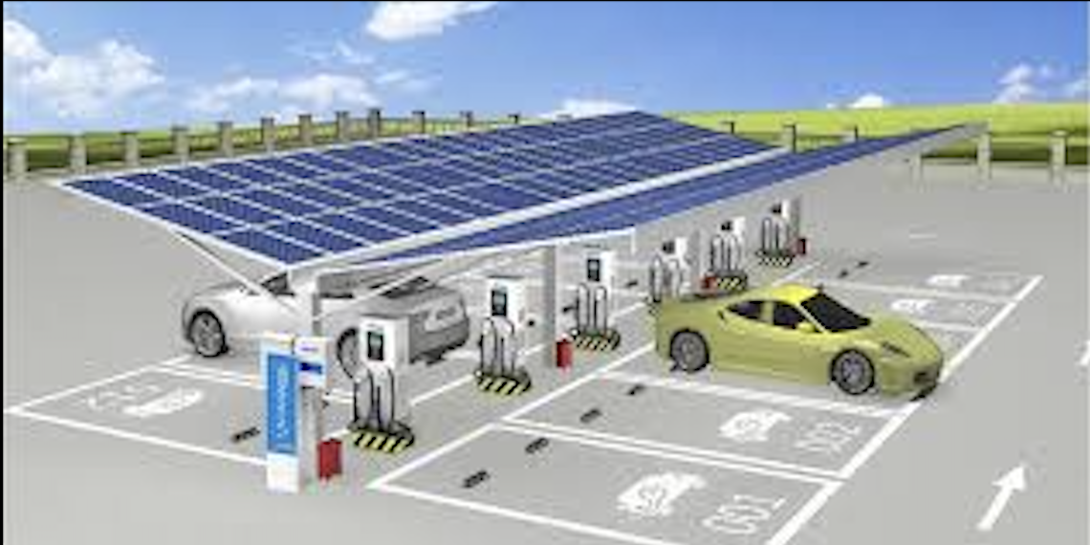
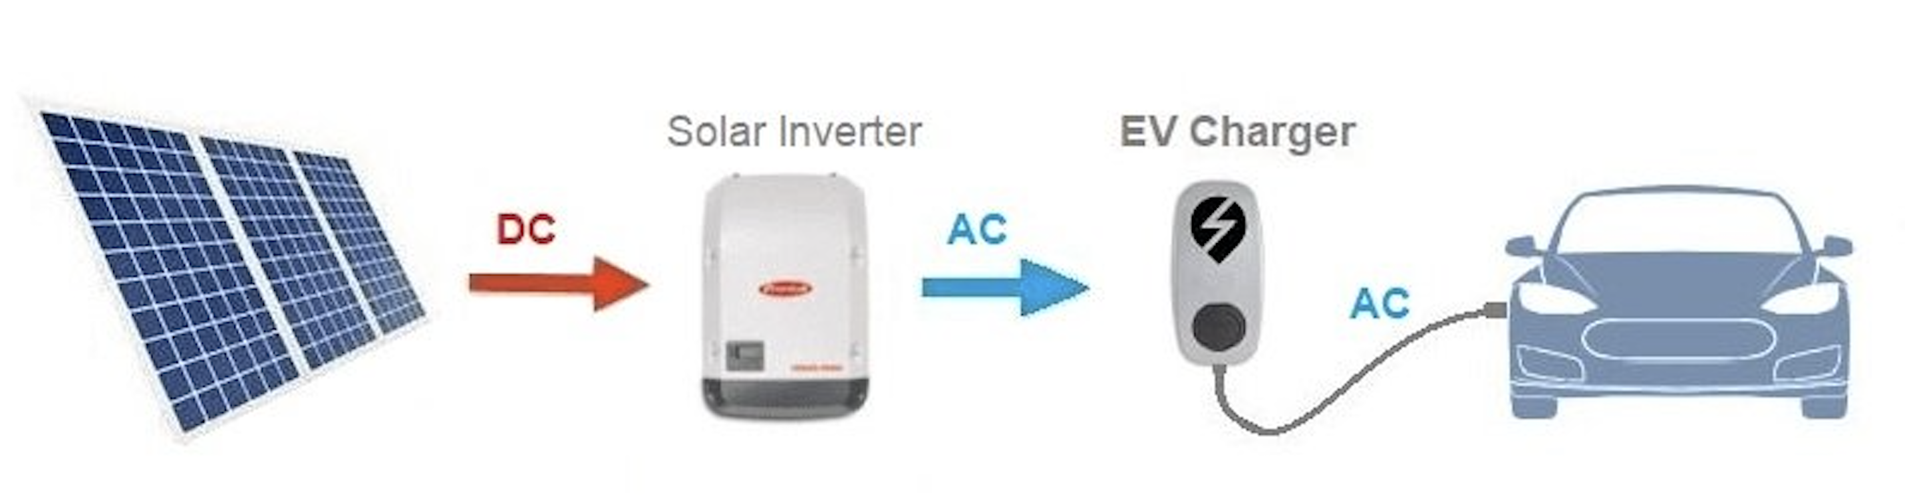
Updation in Solar cell based EV
Perovskite solar cells have shown promise for lightweight and flexible applications. They can be fabricated on various substrates, including flexible plastics, enabling their integration into the roof or body panels of an EV. Perovskite solar cells are still in the early stages of development, but their high efficiency potential makes them an interesting option for future EVs.

Slide 23

SECURITY
Your current location to nearest PCR and your speed dials

Slide 24
OUR SOLUTIONS
Home based commercial charging stations
(A Pitch for service based company)
Liquid Cooling System (for better life of charging cables
A simple update in solar cells for better
use of solar energy
A dedicated safety option for any road
side assistance
ML model for range prediction of vehicles.
ML model for route optmization.
ML model for EV charging station placement in grid.
ML model for predicting life of motor and

